Slide 1
PYQ
GATE 2025 01 : 6 Marks 4 Question
GATE 2025 02 : 2 Marks 2 Question
GATE 2024 01 : 7 Marks 4 Question
GATE 2024 02 : 4 Marks 3 Question
GATE 2023 : 5 Marks 3 Question
GATE 2022 : 4 Marks 3 Question
GATE 2021 01: 7 Marks 4 Question
GATE 2021 02: 8 Marks 5 Question
GATE 2020: 4 Marks 3 Question
GATE 2019: 6 Marks 4 Question
GATE 2018: 4 Marks 2 Question
GATE 2017 01: Marks Question
GATE 2017 02: 4 Marks 3 Question
GATE 2016 01: 5 Marks 3 Question
GATE 2016 02: 3 Marks 2 Question
GATE 2015 01: 4 Marks 2 Question

Slide 2
GATE 2025 01

Slide 3
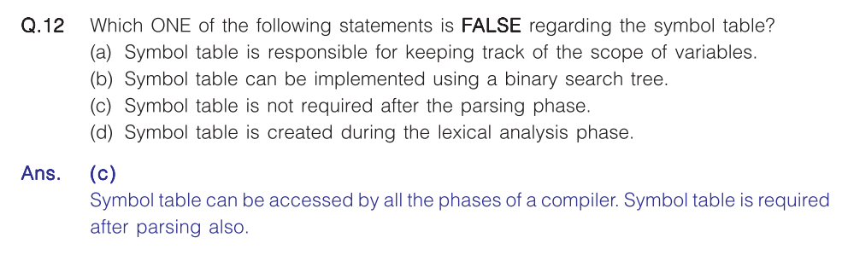

Slide 4
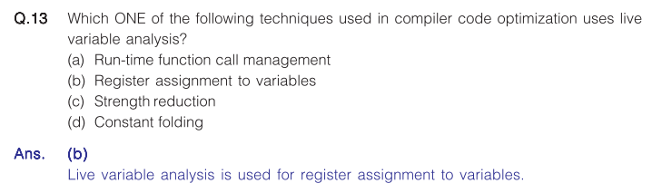

Slide 5
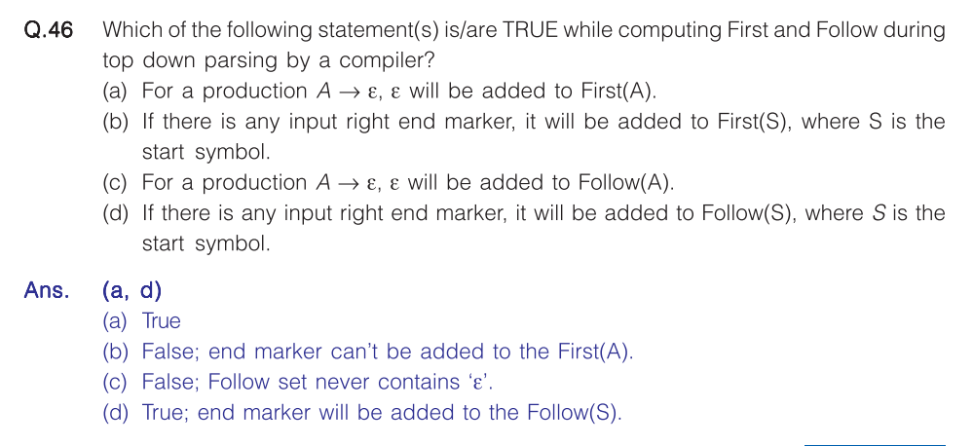

Slide 6
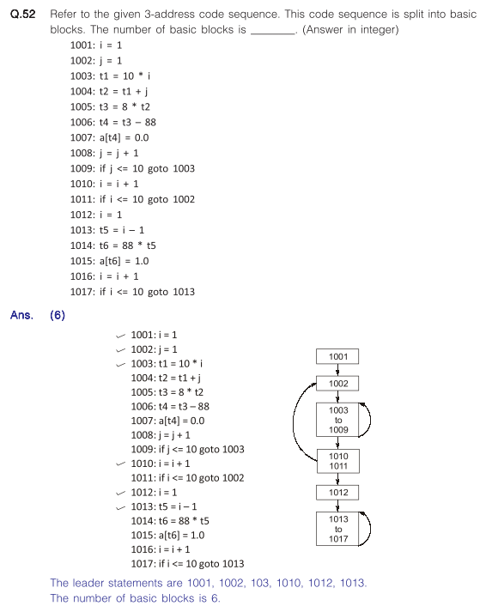
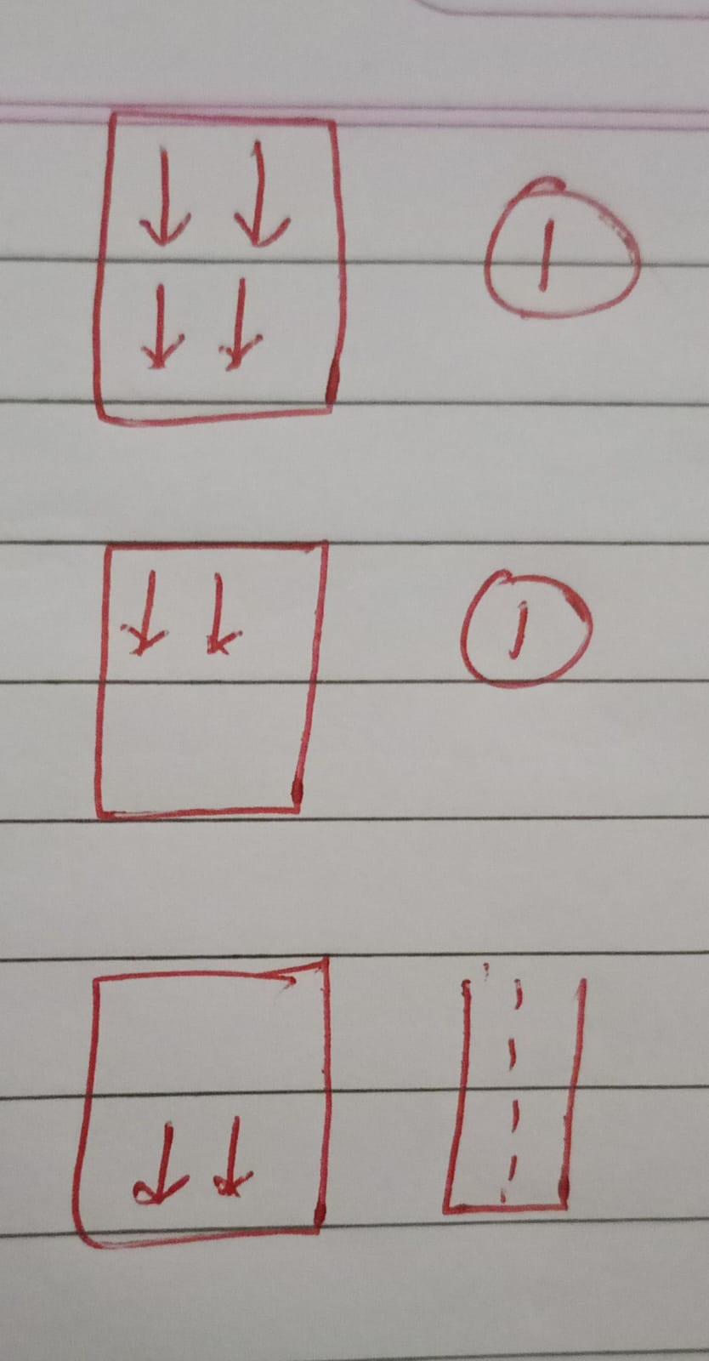

Slide 7
GATE 2025 02

Slide 8
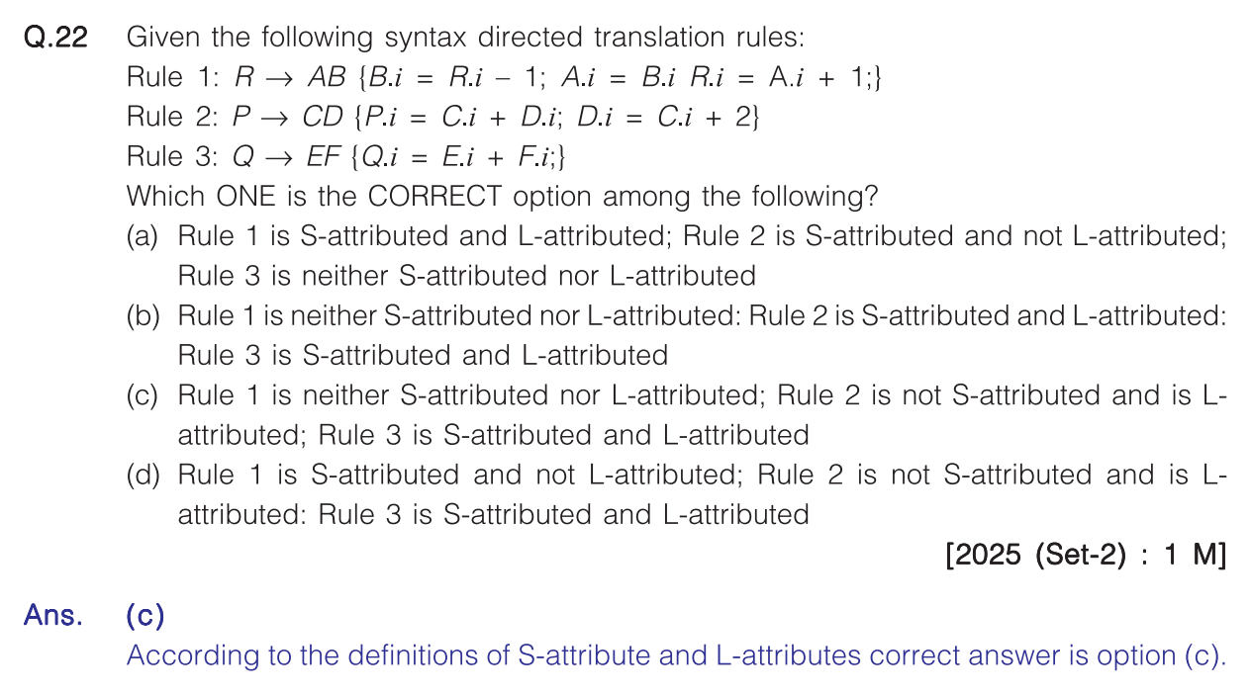

Slide 9
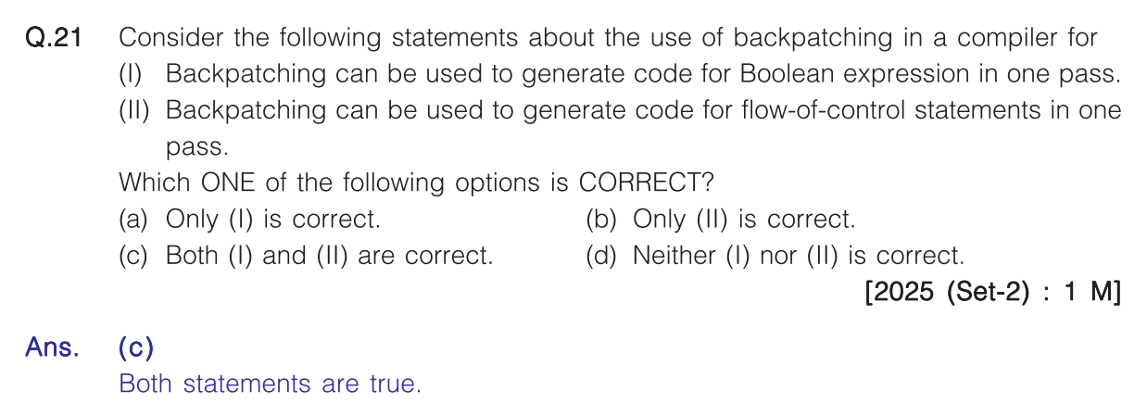

Slide 10
GATE 2024 01

Slide 11
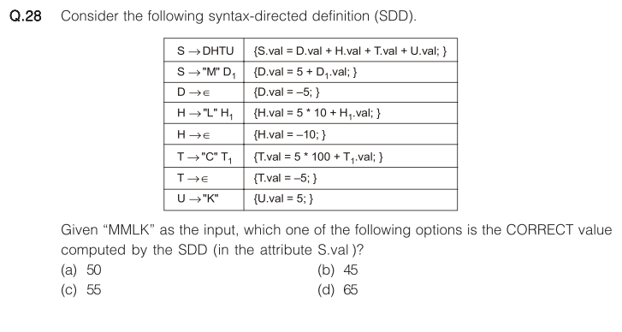
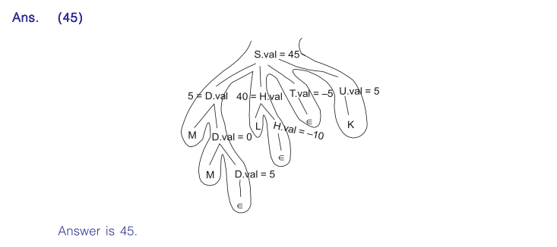

Slide 12
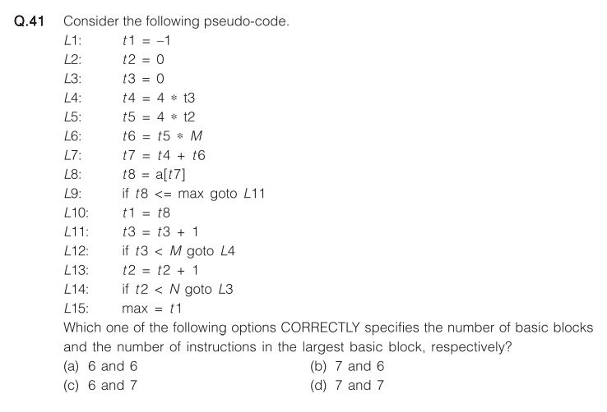
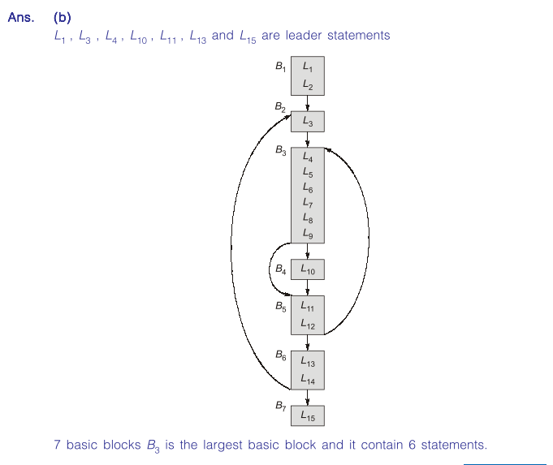

Slide 13
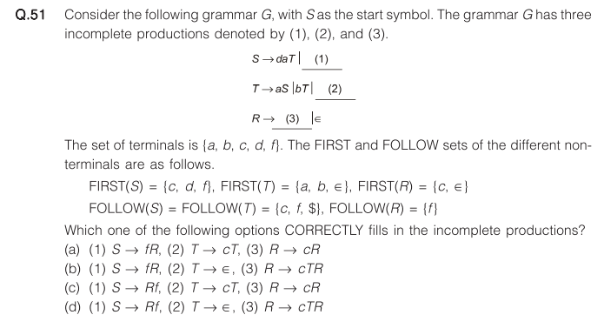
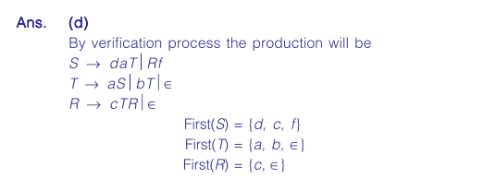

Slide 14
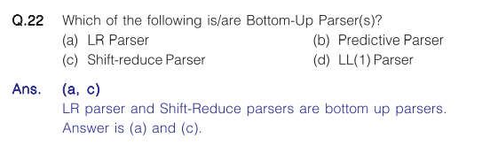

Slide 16
GATE 2024 02

Slide 17
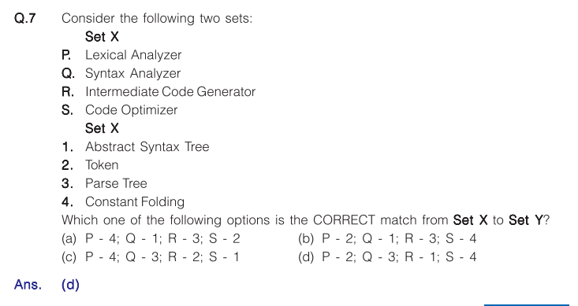

Slide 18
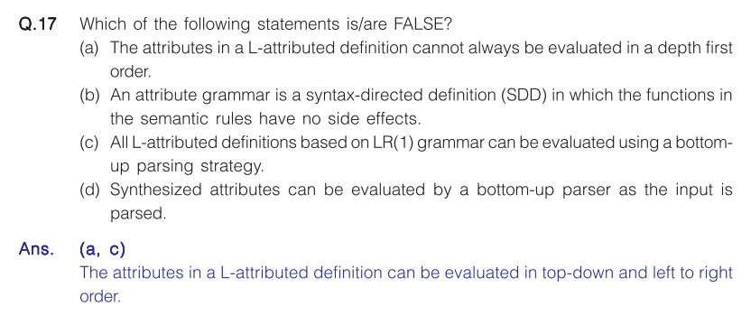

Slide 19
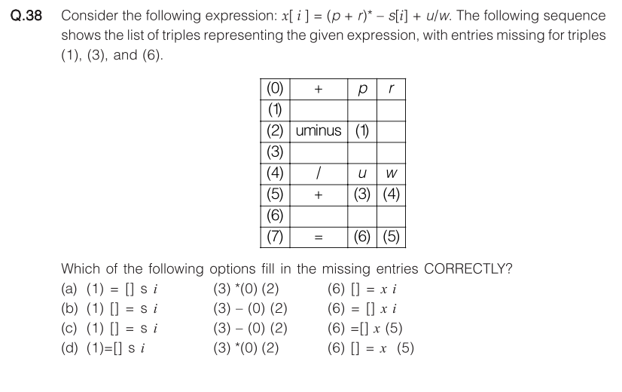
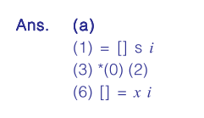

Slide 20
GATE 2023

Slide 21
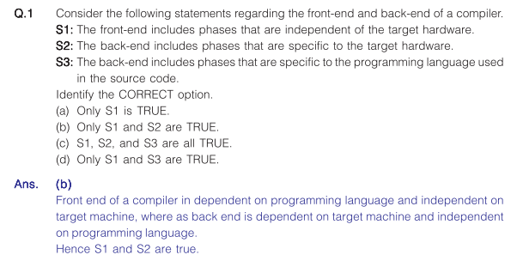

Slide 22
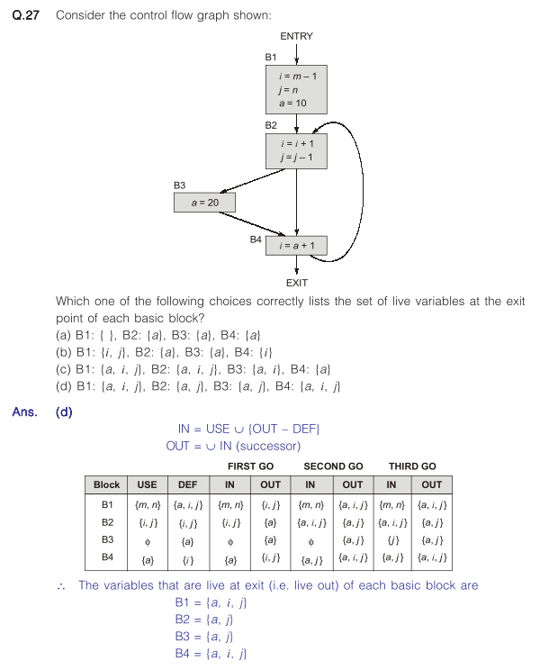

Slide 23
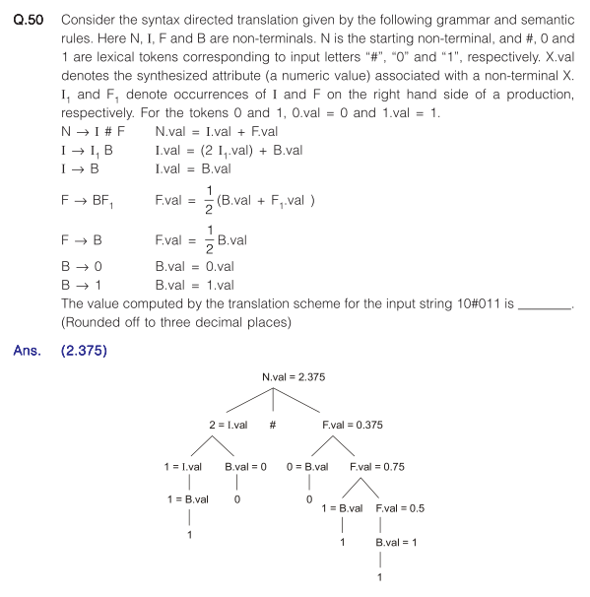

Slide 24
GATE 2022

Slide 25
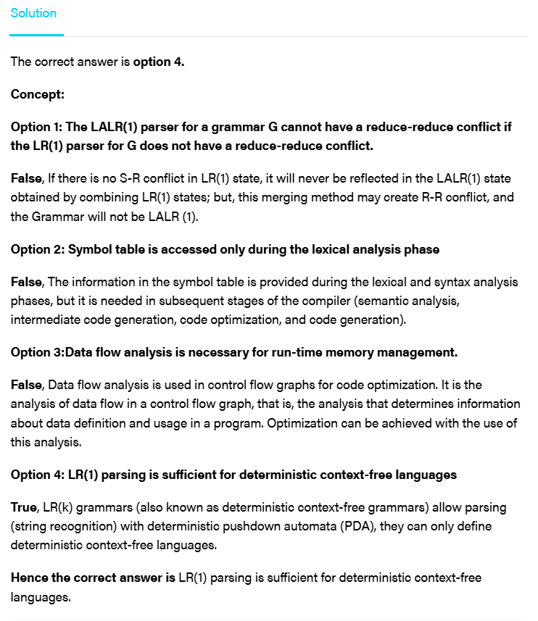
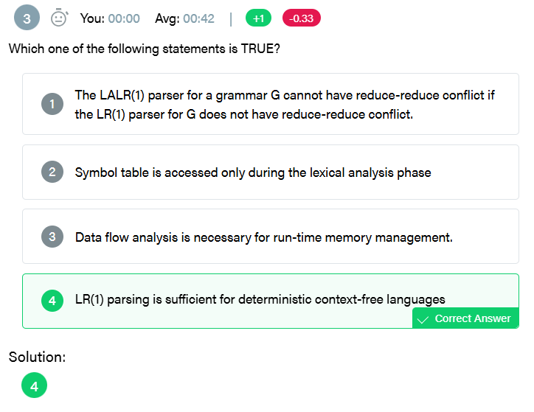

Slide 26
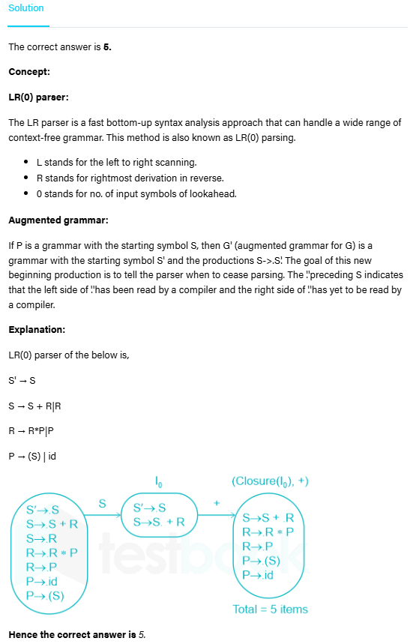
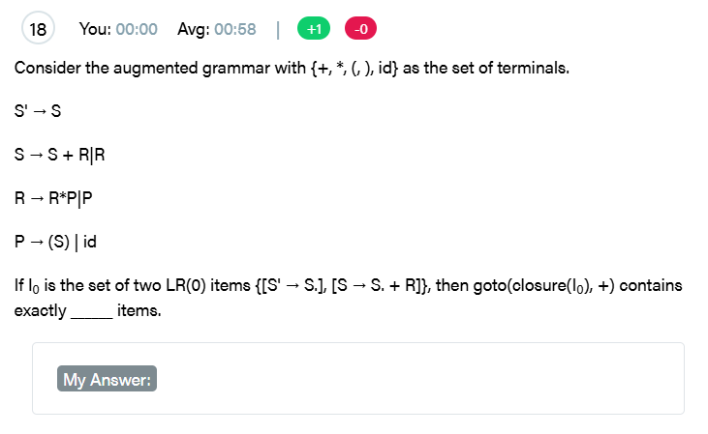

Slide 27
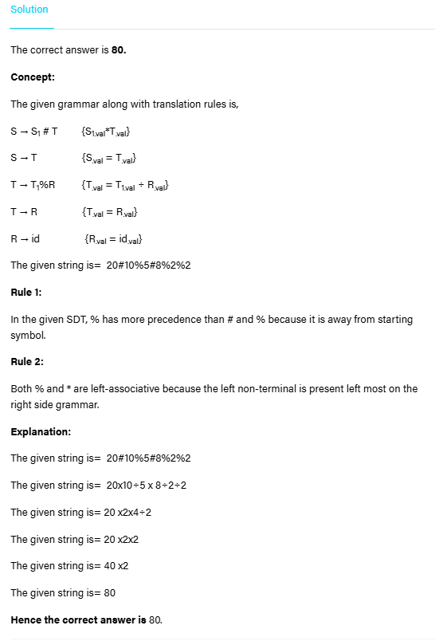
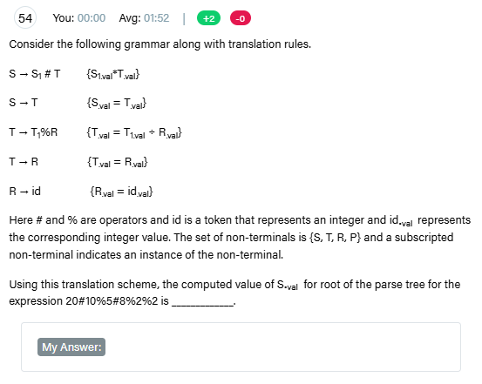

Slide 28
GATE 2021 01

Slide 29
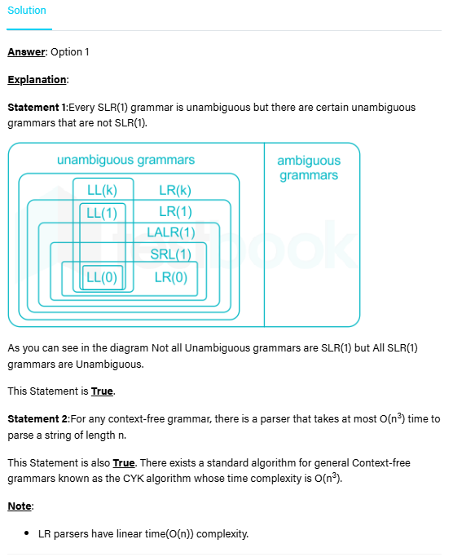
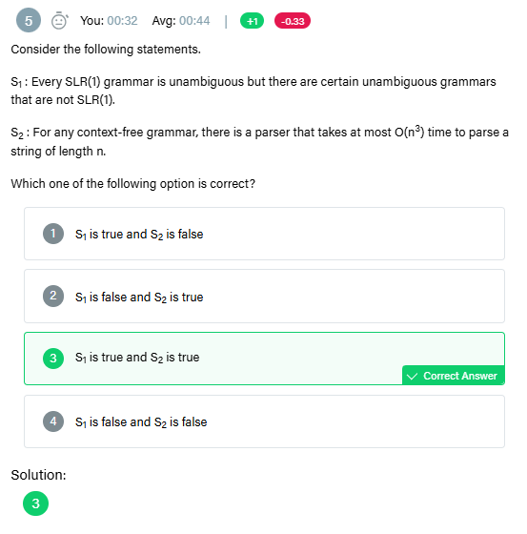

Slide 30
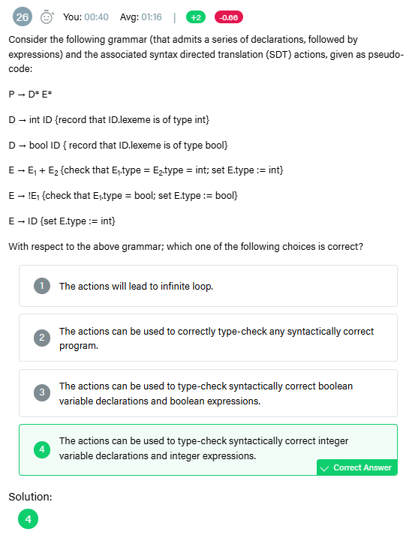
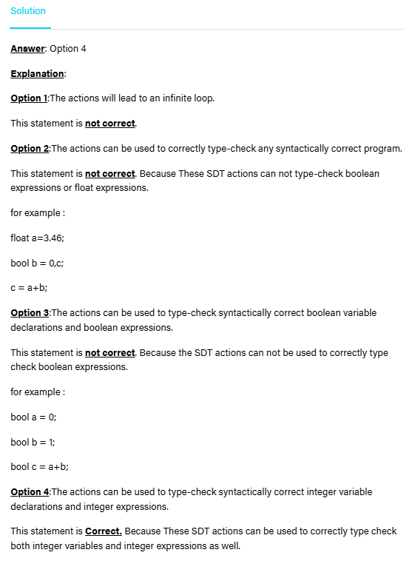

Slide 31
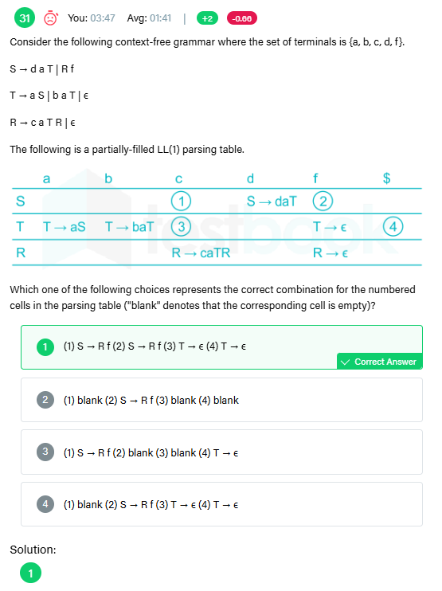
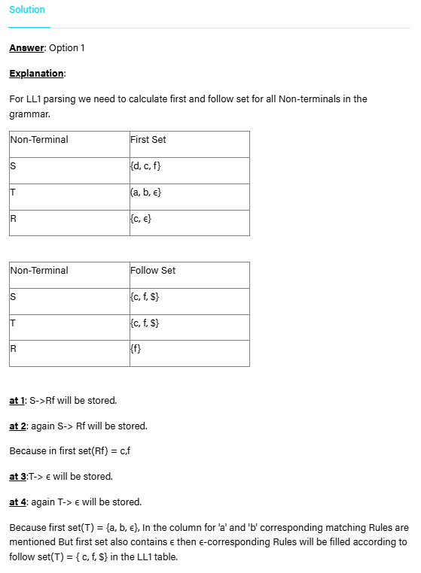

Slide 32
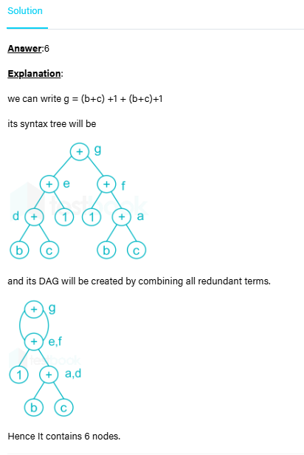
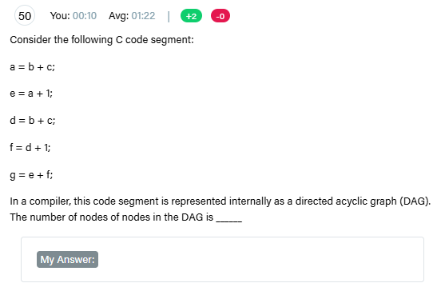

Slide 33
GATE 2021 02

Slide 34
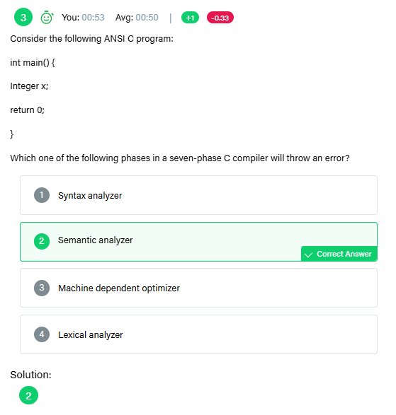
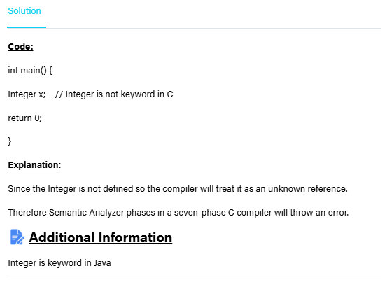

Slide 35
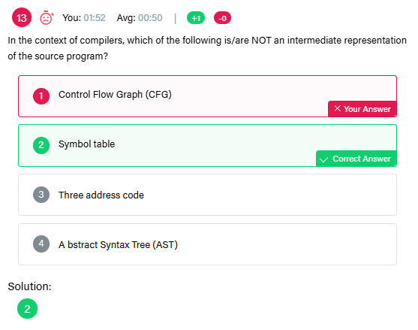
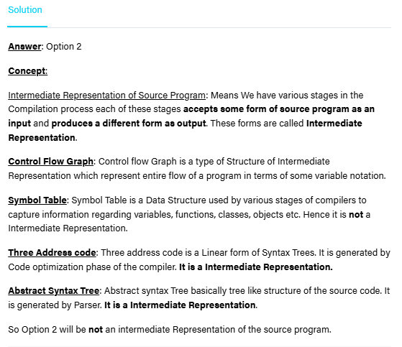

Slide 36
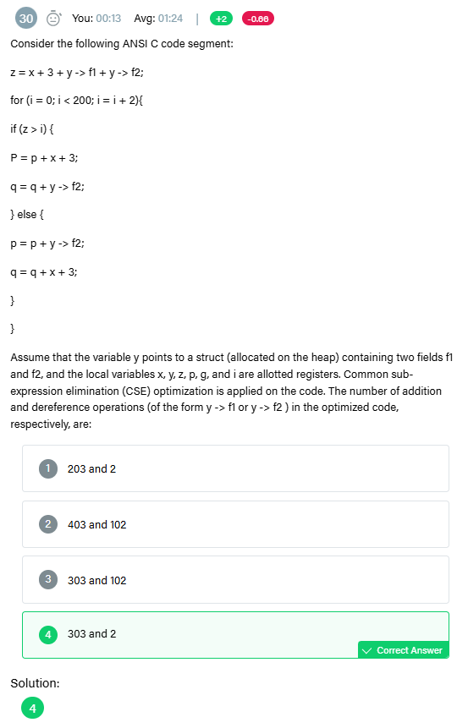
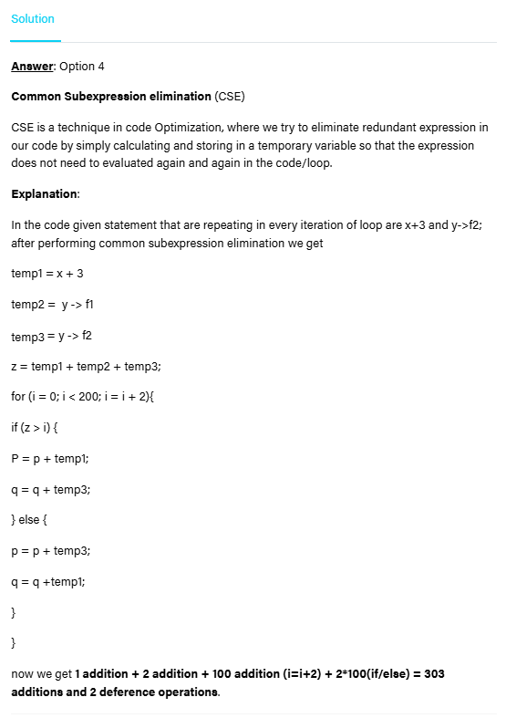

Slide 37
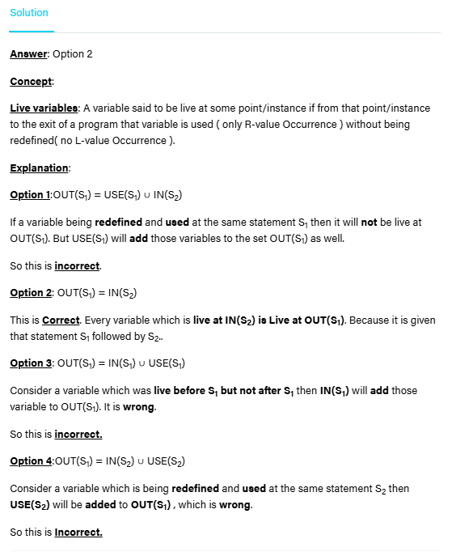
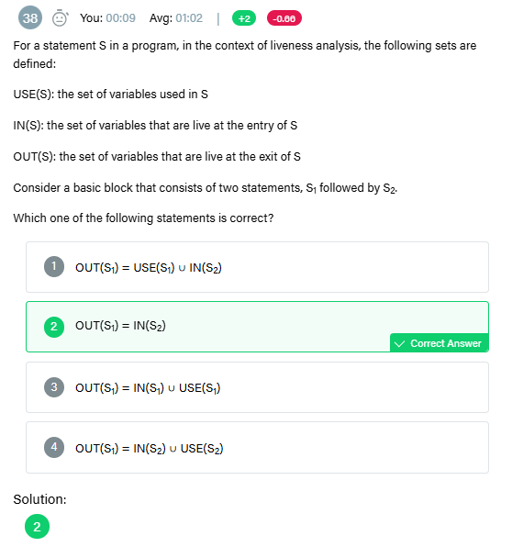

Slide 38
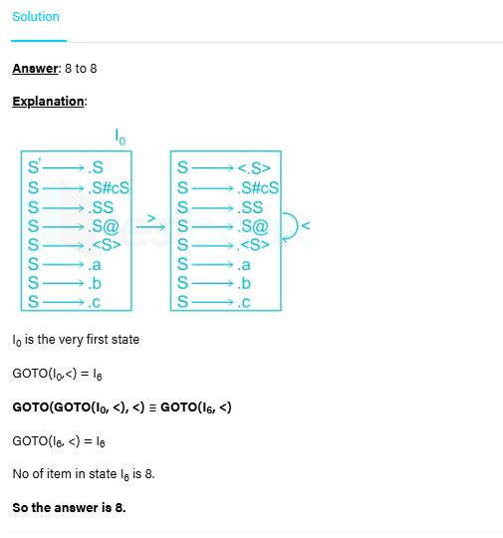
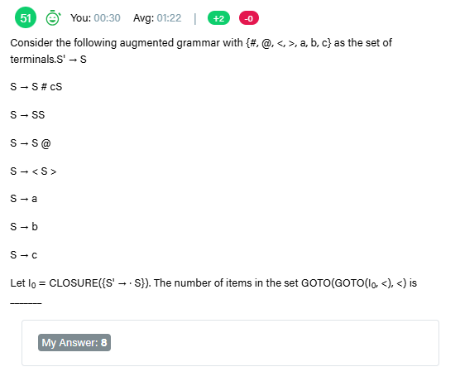

Slide 39
GATE 2020

Slide 40
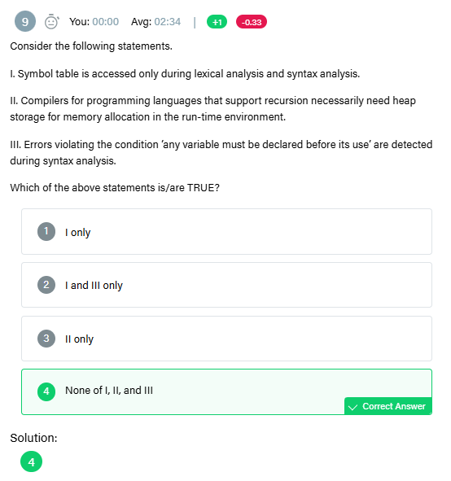
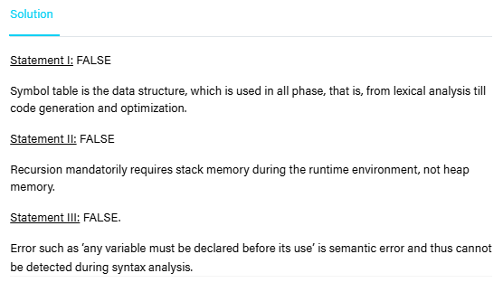

Slide 41
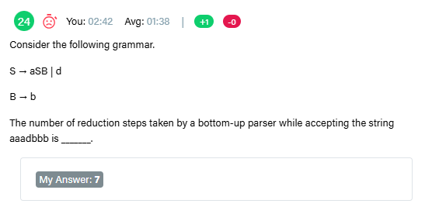
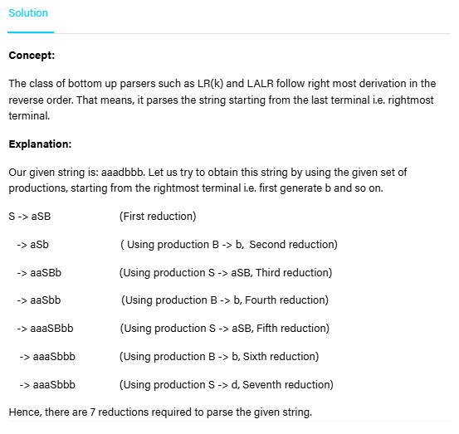

Slide 42
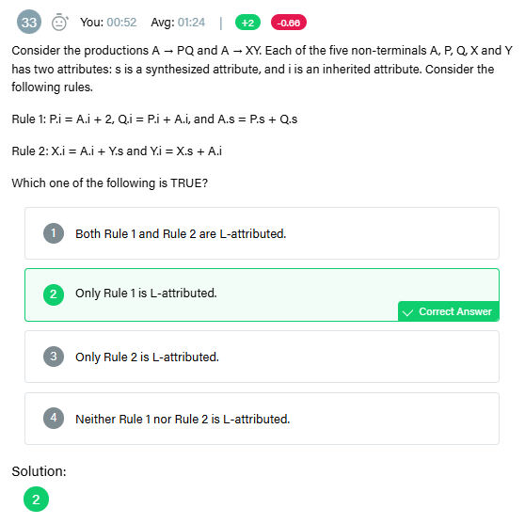


Slide 43
GATE 2019

Slide 44


Slide 45



Slide 46



Slide 47


Slide 48
GATE 2018

Slide 49



Slide 50



Slide 51
GATE 2017 02

Slide 52



Slide 53


Slide 54



Slide 55
GATE 2016 01

Slide 56




Slide 57


Slide 58



Slide 59
GATE 2016 02

Slide 60



Slide 61



Slide 62
GATE 2015 01

Slide 63



Slide 64



